Slide 1
Part Consolidation Candidate Detection for Additive Manufacturing
This is the template

Slide 2
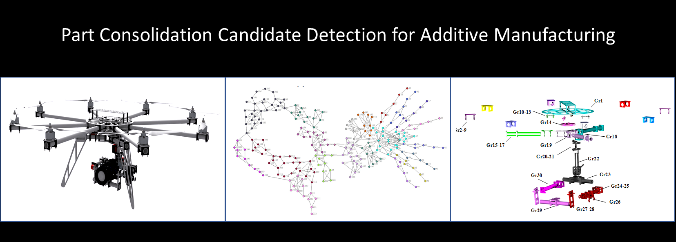

Slide 3
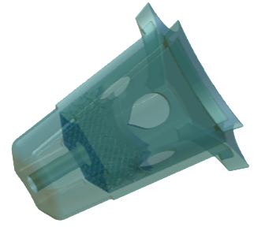
Part Fusion with Additive Manufacturing
7 parts in 1
25% weight savings

Slide 4
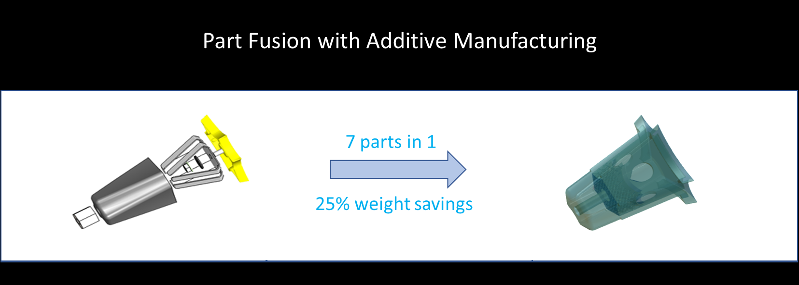

Slide 5
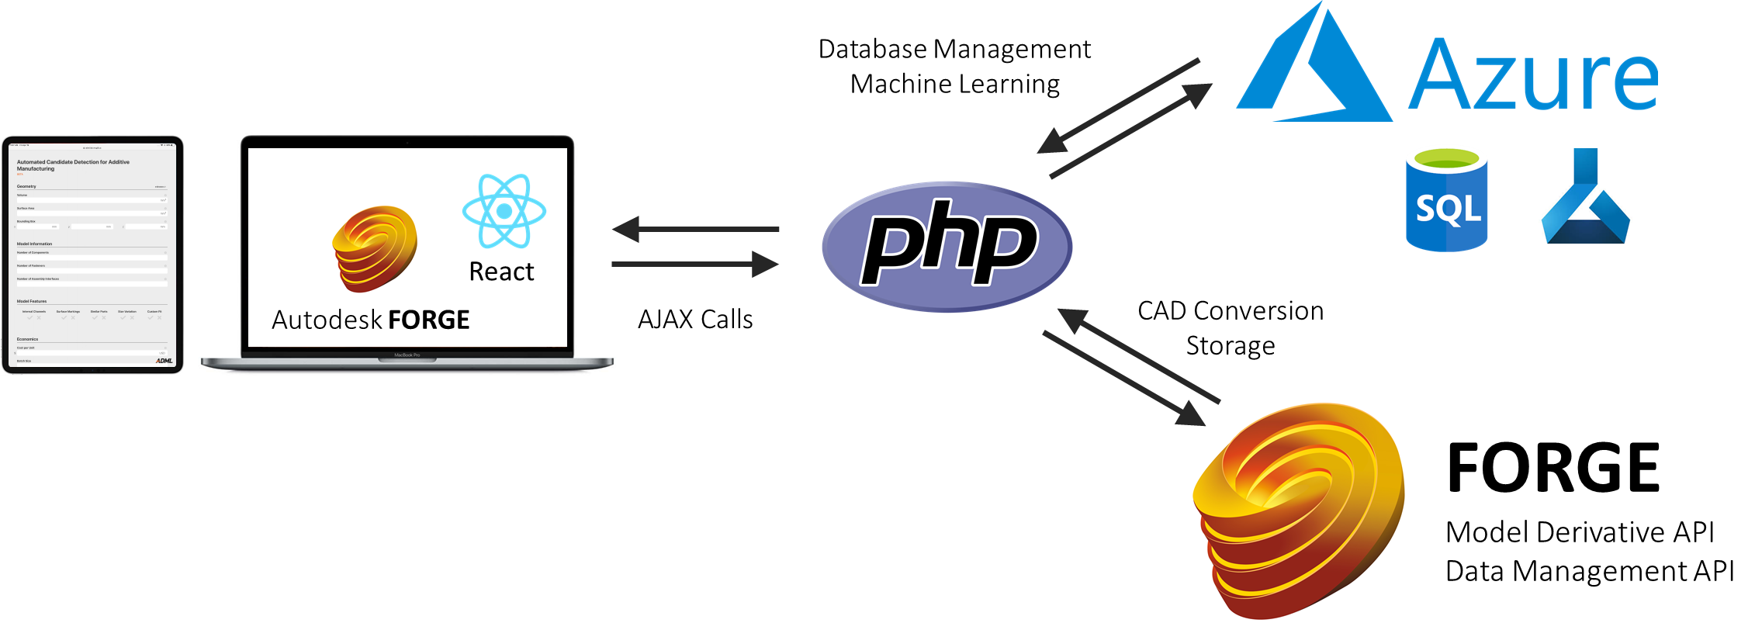
Architecture for Automated AM Candidacy Detection

Slide 6
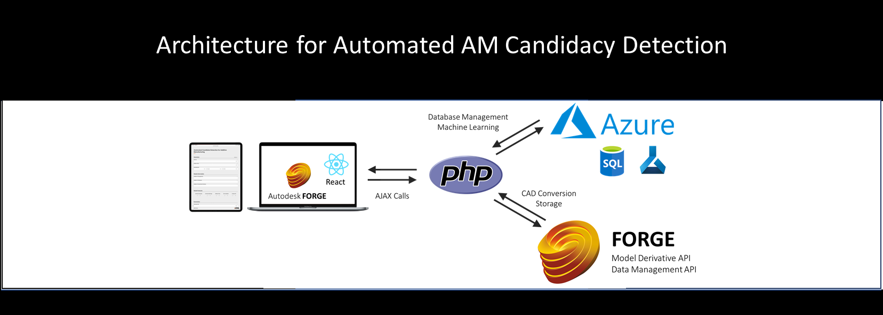

Slide 7
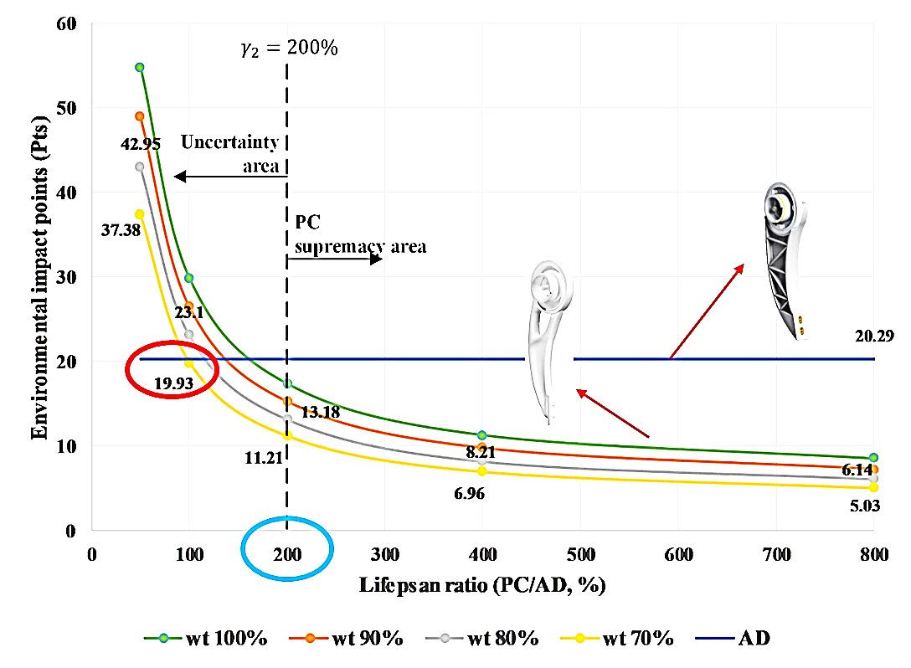
Sustainable Additive Manufacturing with Part Consolidation

Slide 8
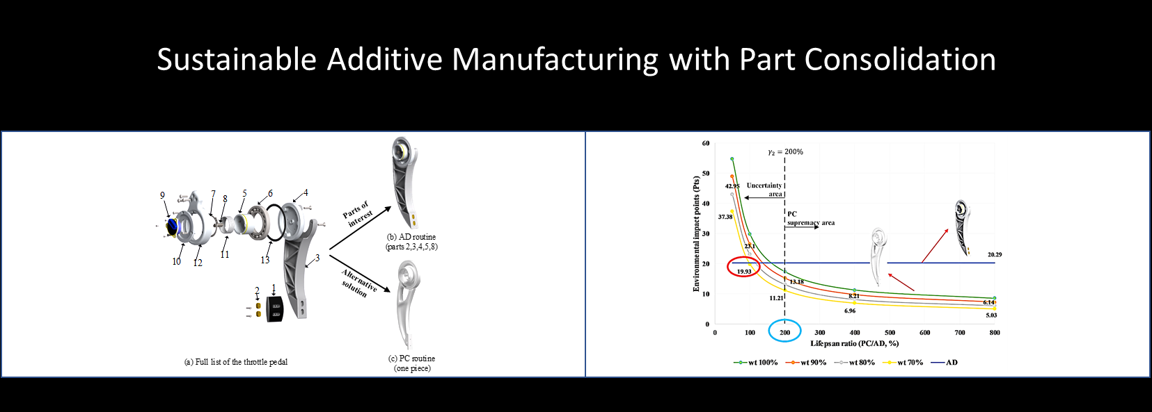

Slide 9
